Slide 1
Scrotum & Testes
Dr Abdul Hafeez Khan

Slide 2
Scrotum
Sac of skin and superficial fascia that hangs outside the abdominopelvic cavity at the root of the penis
Contains paired testicles separated by a midline septum
Its external positioning keeps the testes 2-3°C lower than core body temperature

Slide 3
Wall of the Scrotum
Skin:
The skin of the scrotum is thin, wrinkled, and pigmented and forms a single pouch.
A slightly raised ridge in the midline indicates the line of fusion of the two lateral labioscrotal swellings.
In the female, the swellings remain separate and form the labia majora

Slide 4
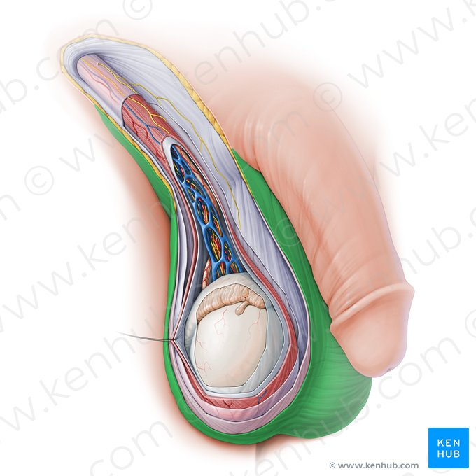
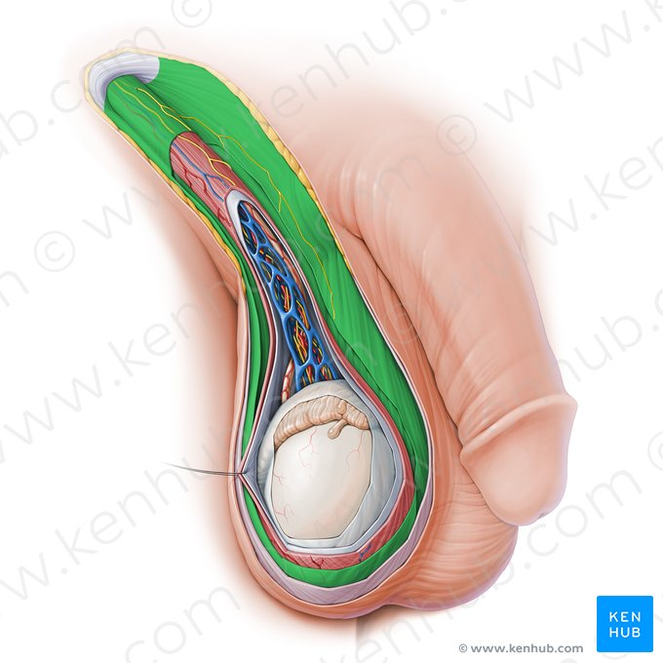

Slide 5
Wall of the Scrotum
Superficial Fascia:
2 layers of superficial fascia in anterior abdominal wall
Fatty layer (Camper’s fascia) Dartos muscle
Membranous layer (Scarpa’s fascia) Colle’s fascia
Dartos muscle is innervated by sympathetic nerve fibers
Responsible for the wrinkling of the overlying skin
Both layers contribute to a median partition that crosses the scrotum and separates the testes from each other

Slide 6
Wall of the Scrotum
Spermatic Fascia:
3 layers derived from anterior abdominal wall
External spermatic fascia: Aponeurosis of external oblique (Not muscle)
Cremasteric fascia: Cremaster muscle which originate from ??
Internal spermatic fascia: Fascia transversalis

Slide 7
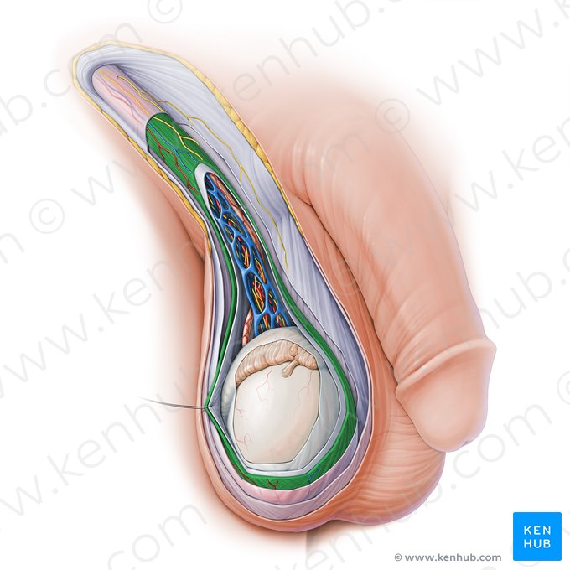
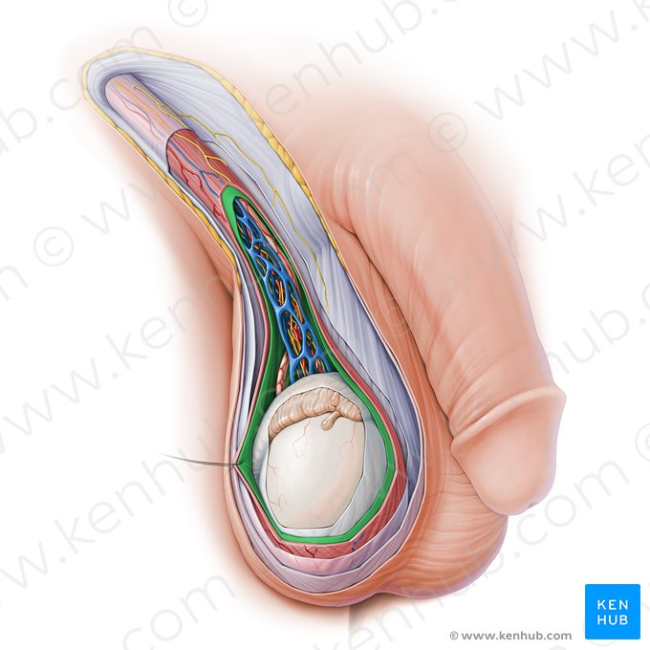

Slide 8
Wall of the Scrotum
Tunica Vaginalis:
2 layers: Parietal & Visceral
This lies within the spermatic fascia and covers the anterior, medial, and lateral surfaces of each testis.
It is the lower expanded part of the processus vaginalis
Just before birth, it becomes shut off from the upper part of the processus and the peritoneal cavity.
The tunica vaginalis is thus a closed sac, invaginated from behind by the testis

Slide 9
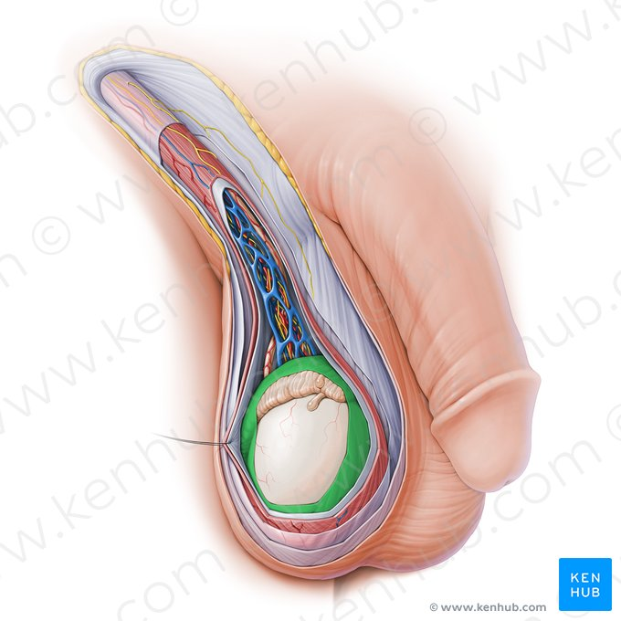
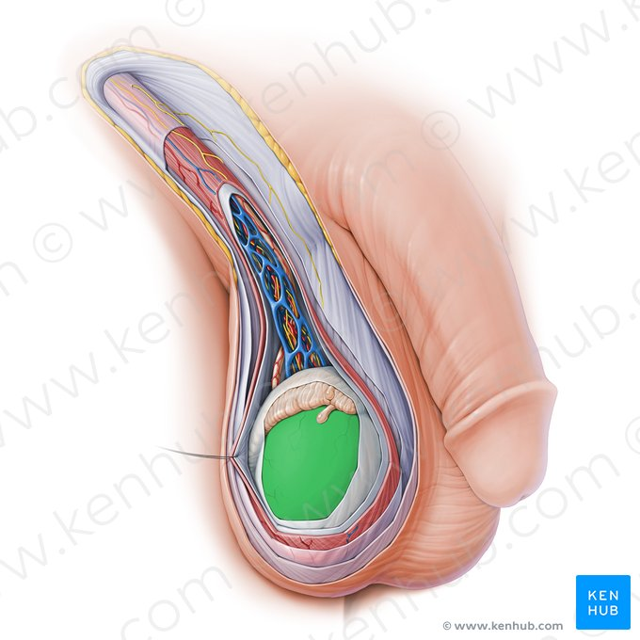

Slide 10
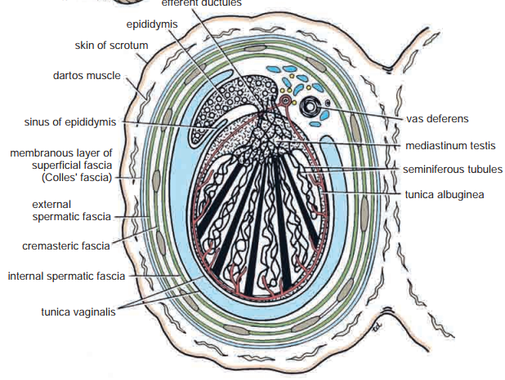

Slide 11
Blood supply of scrotum
Arterial supply:
Internal iliac Internal Pudendal Perineal Posterior scrotal artery
External iliac Femoral External pudendal Superficial
Deep
Both supply Scrotum
Venous drainage:
The veins accompany the arteries

Slide 12
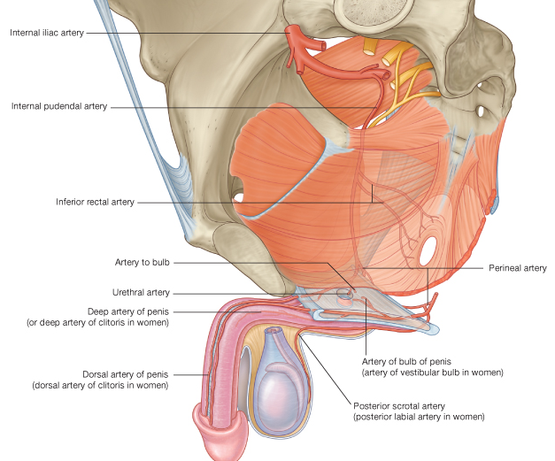

Slide 13
Lymph drainage & Nerve supply
Lymph from the skin and fascia, including the tunica vaginalis drains into the superficial inguinal lymph nodes
Nerve supply:
The scrotum is innervated:
Anteriorly by the Ilioinguinal and genitofemoral nerves
Posteriorly is innervated by the perineal branches of the pudendal nerves

Slide 14
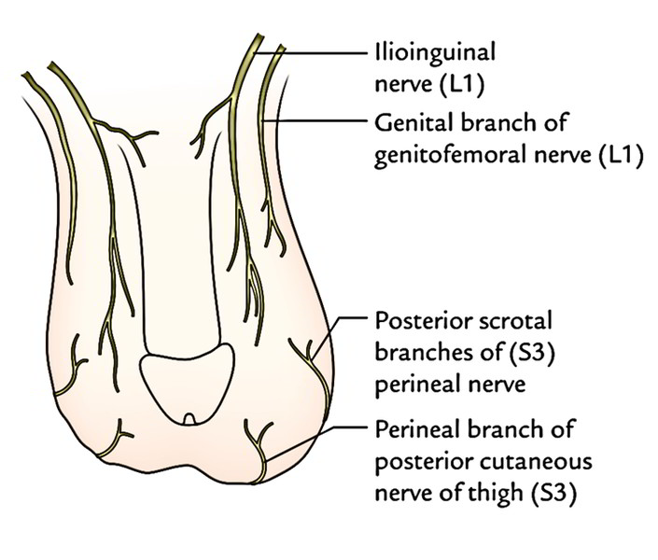

Slide 15
Testes
The testis is a firm, mobile organ lying within the scrotum.
The left testis usually lies at a lower level than the right (Why?)
Each testis is surrounded by a tough fibrous capsule, the tunica albuginea.

Slide 16
Coverings of testes
Tunica Vaginalis:
Peritoneal covering, formed of parietal and visceral layers.
It surrounds testis & epididymis.
It allows free movement of testis within the scrotum.
Tunica albugenia:
It is a whitish fibrous capsule.

Slide 17
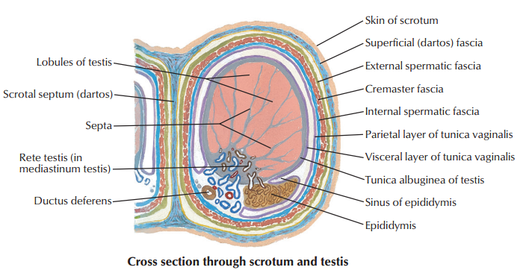

Slide 18
Internal structure of testes
Fibrous septa divide the testis into a (200-300) -average 250- lobules.
Each lobule contains (1-3) seminiferous tubules.
Seminiferous Tubules: (60 cm coiled tubule).
They are the site of the spermatogenesis.
They form the bulk of testicular tissue.
Interstitial cells of Leydig secrete Testosterone.
Rete testis:
A network of tubules.
It is the site of merging of the Seminiferous tubules.

Slide 19
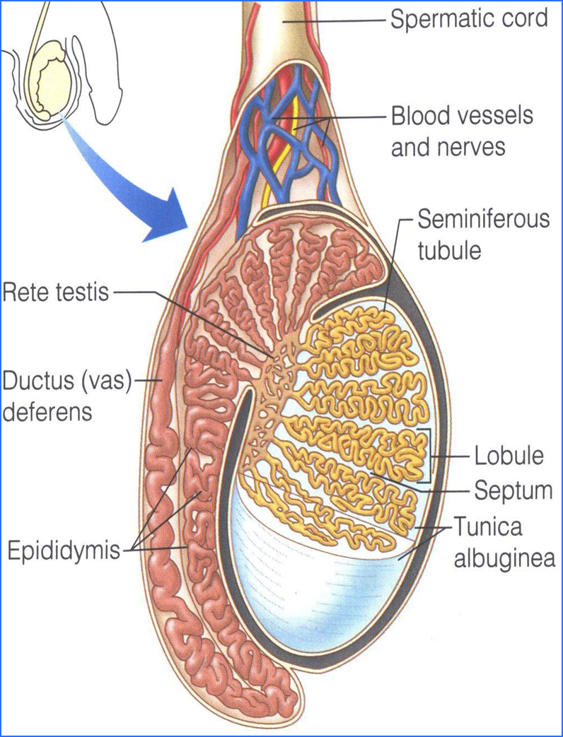

Slide 20
Blood supply of testes
Arterial supply:
Testicular artery: It arises from the abdominal aorta at the level of L ??.
Venous drainage:
Pampiniform plexus of veins.
About dozen of veins which forms a network in the spermatic cord.
They become larger, converge as it approached the inguinal canal to form the Testicular vein.
Right Vein drains into IVC.
Left Vein drains into left renal vein.

Slide 21
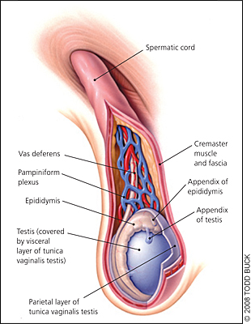

Slide 22
Epididymis
A Single coiled tubule 6 meters long.
Located on the superior and posterior margins of the testis.
It is divided into 3 parts:
Head, Body and Tail.
The Head receives efferent ductules from the rete testis
The Tail is continuous with Vas Deferens.
Functions:
1. Secretes/absorbs the nourishing fluid.
2. Recycles damaged spermatozoa.
3. Stores spermatozoa Up to 2 weeks to allow for maturation.

Slide 23
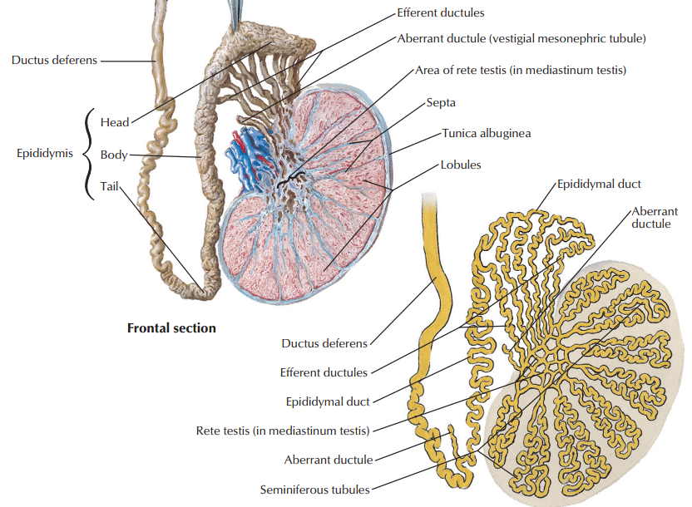

Slide 24
Vas deferens
A muscular tube 45 cm long.
Carries sperms from the epididymis to pelvic cavity.
Passes through the inguinal canal.
It crosses the ureter.
Its terminal part is dilated to form the Ampulla of the vas
It joins the duct of the seminal vesicle to form ejaculatory duct which opens in the prostatic urethra.

Slide 25
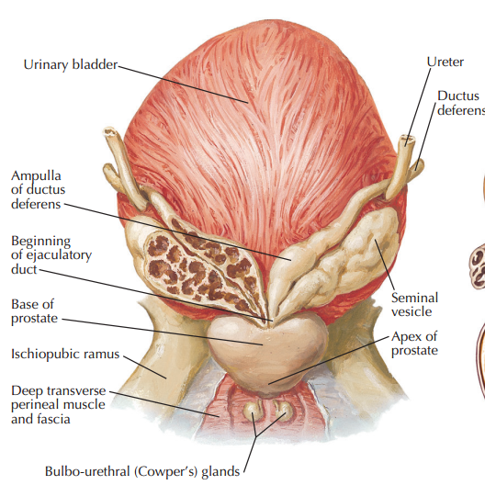

Slide 26
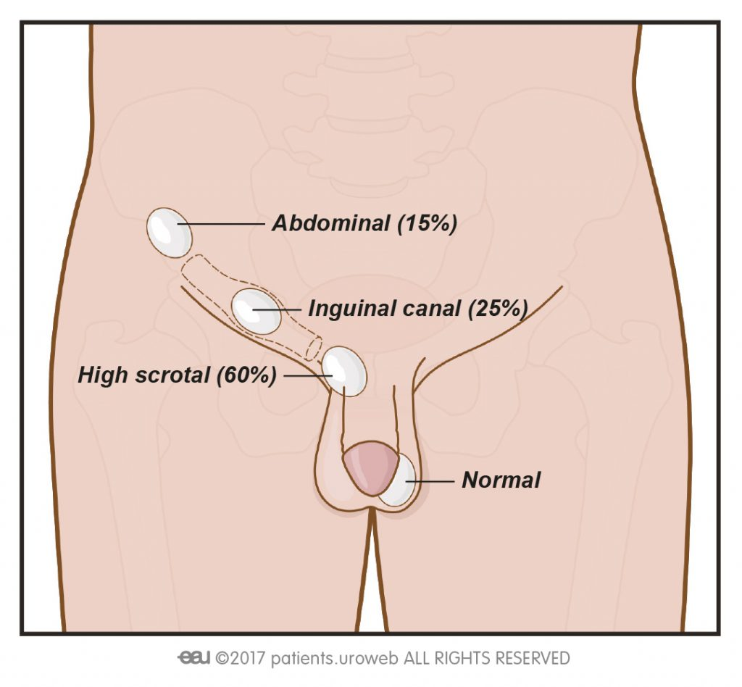
Cryptorchidism

Slide 27
Assessment
Which structure is involved in transporting spermatozoa from the epididymis to the ejaculatory ducts?
Corpus spongiosum of penis
Corpus cavernosum of penis
Ductus deferens
Urethra
Body of Penis
Key: Ducrus Deferens

Slide 28
Assessment
Which of the following structures is the continuation of the straight tubules found within the mediastinum of the testis?
Convoluted seminiferous tubule
Appendix of testes
Spermatic cord
Rete testes
Distal Tubule
Key: Rete testes

Slide 29
Assessment
Which is the structure responsible for suspending the testis in the scrotum?
Seminal gland
Rete testes
Ductus deferens
Epididymis
Spermatic cord
Key: Spermatic cord

Slide 30
Assessment
Which reproductive organs completely or partially drain directly into abdominal lymph nodes in males and females?
Ovary
Epididymis
Vagina
Uterine tube
Testes
Key: a,b,d,e

Slide 31
Assessment
What is the inner layer of the tunica of the testis called?
Adventitia
Capsule of Prostate
Tunica vasculosa
Tunica vaginalis
Internal spermatic fascia
Key: Tunica vasculosa

Slide 32
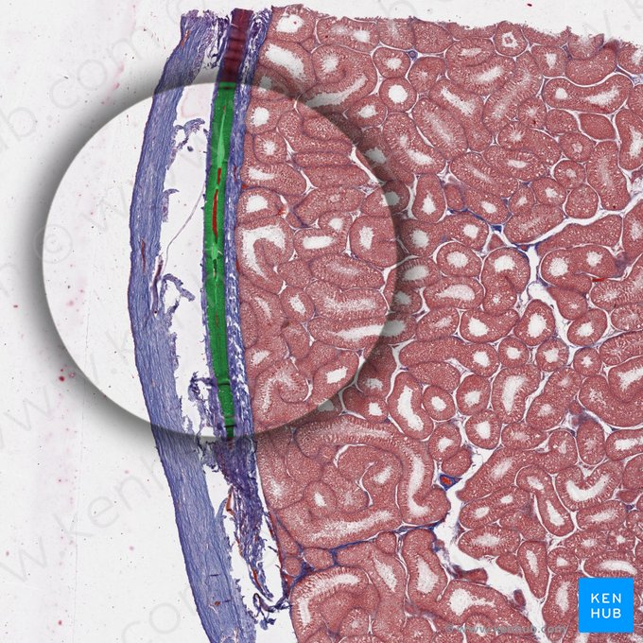

Slide 33


