Slide 1
Prostate and Urethra
Dr Abdul Hafeez Khan

Slide 2
Gross Anatomy
It is a walnut sized, fibromuscular glandular tissue.
Located at the neck of bladder.
Traversed by the prostatic urethra.
Secretes (20-30% of semen)
Shape: Conical
It has:
Base (Superior): Attached to neck of urinary bladder
Apex (Inferior): Rests on the Urogenital diaphragm.
Composed of
1. Glandular elements (70%)
2. Fibromuscular stroma (30%)

Slide 3
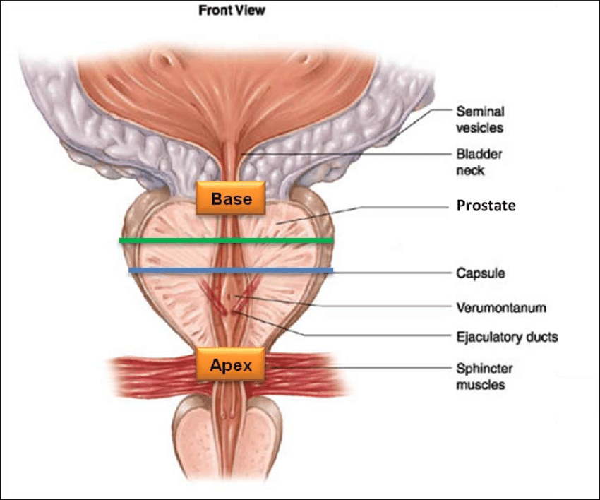

Slide 4
Gross Anatomy
The base of the prostate is at the bladder-prostate junction.
Apex is the narrowest and the most inferior portion of the prostate gland.
Sits on urogenital diaphragm.
Palpable on DRE (~ 4 cm).

Slide 5
Capsule of Prostate
Internally, it has a dense fibrous capsule (prostatic capsule), which is surrounded from outside by a fibrous prostatic sheath (fascia).
The prostatic fascia is continuous with the puboprostatic part of the levator ani muscle. (levator prostate).
In between the prostatic capsule and the prostatic facial sheath lies the prostatic venous plexus.

Slide 6
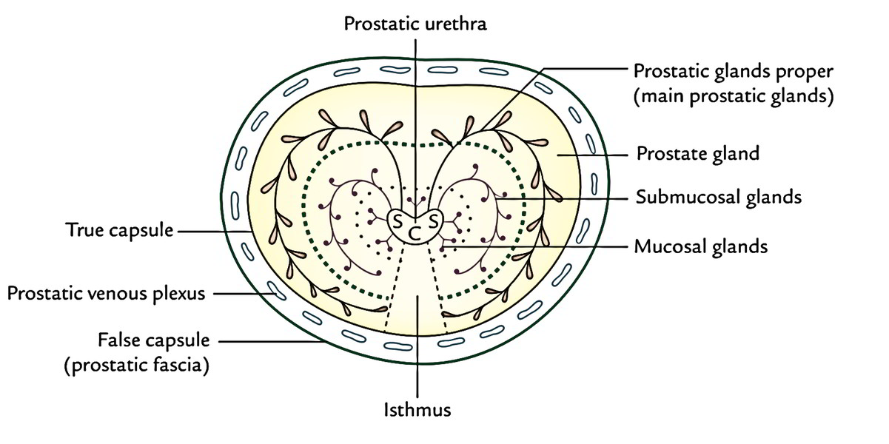

Slide 7
Fascia of Prostate
Three separate fascial structures surround the prostate.
1. Denonvilliers fascia
2. The prostatic fascia
3. The endopelvic fascia

Slide 8
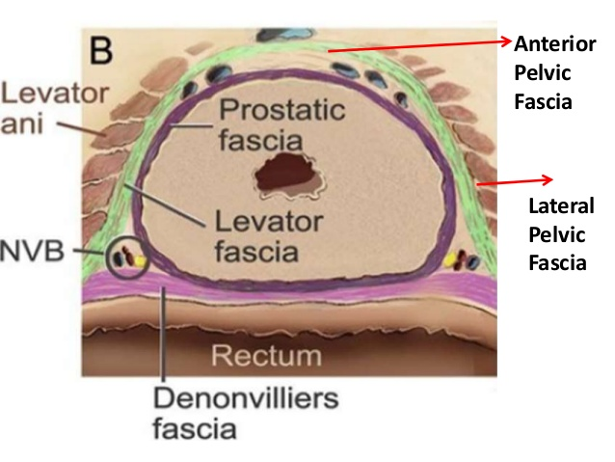

Slide 9
Denonvillier's fascia
“The plane between wind and water”
Denonvilliers' fascia lies posteriorly, adherent to the prostate, present between prostate and the rectum.
It also covers the posterior surface of the seminal vesicles.
Denonvilliers' fascia forms an important barrier to the spread of prostatic and rectal malignancy

Slide 10
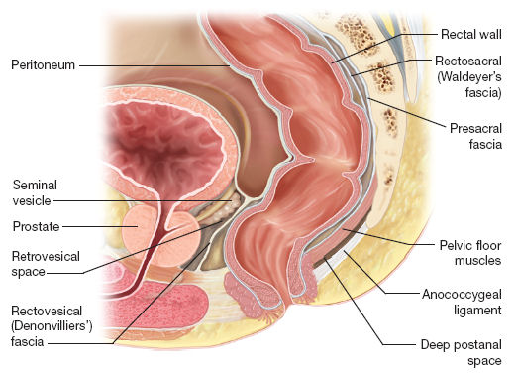

Slide 11
Prostatic fascia
“The prostatic fascia surrounds the prostate gland.
Anteriorly and antero-laterally, it is in direct continuity with the fibromuscular stroma of the prostate.
Laterally, it fuses with the endopelvic fascia.
Posteriorly, it fuses with and is indistinguishable from Denonvilliers' fascia.

Slide 12
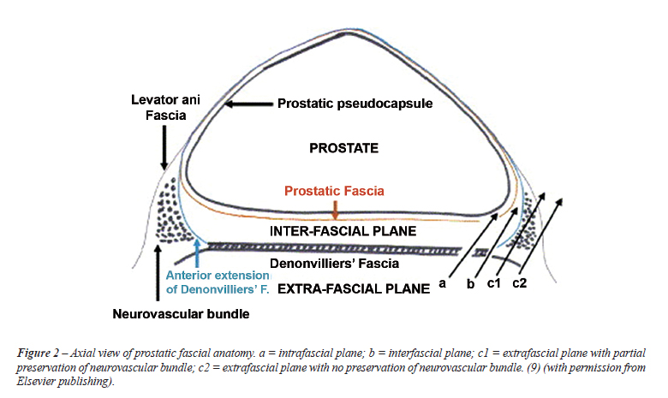

Slide 13
Endopelvic fascia
“Endopelvic fascia refers to the parietal pelvic fascia in the region of the prostate, overlying the levator ani muscle.
The prostate capsule blends with the continuation of the endopelvic fascia on the anterior and anterolateral aspects of the prostate.
The prostate receives its blood supply and autonomic innervation between the layers of endopelvic fascia and the prostatic fascia.

Slide 14
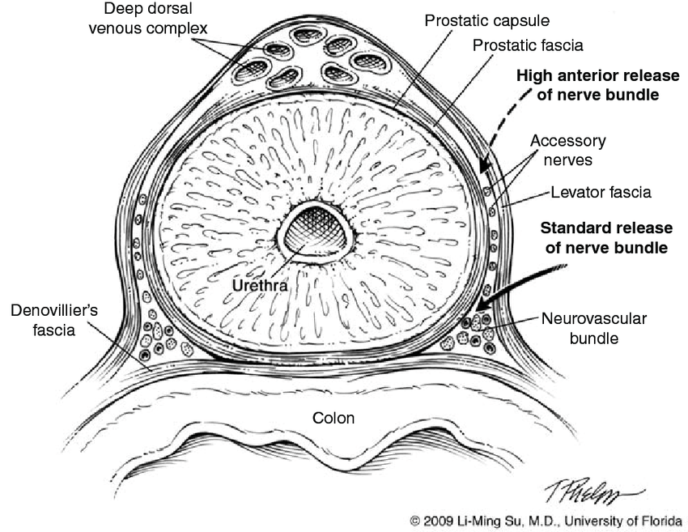

Slide 15
Zones of Prostate
The prostate has been divided into distinct anatomic zones.
1. Transition zone
2. Central zone
3. Peripheral zone

Slide 16
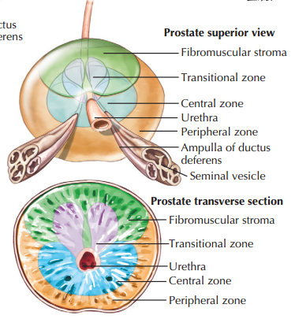

Slide 17
Transition zone
“Transition zone is the smallest of the zones of the prostate.
5% to 10%.
The transition zone is separated from the rest of the glandular compartments of the prostate by a distinct fibromuscular band.
Benign prostatic hyperplasia most commonly occurs in the transition zone.

Slide 18
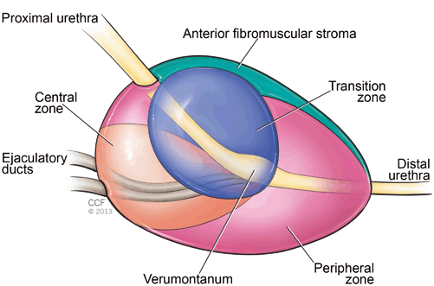

Slide 19
Central zone
The central zone ducts are positioned circumferentially, surrounding the openings of the ejaculatory ducts.
This zone expands toward the base of the bladder, surrounding the ejaculatory ducts in the shape of a cone.
The central zone comprises 25% of the glandular tissue of the prostate.

Slide 20
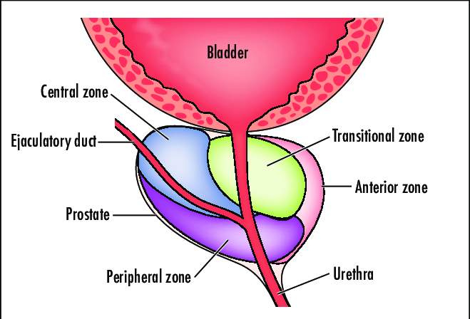

Slide 21
Peripheral zone
The peripheral zone of the prostate is the largest zone (70%).
Makes up the posterior and lateral aspects of the prostate gland.
Seventy percent of prostate cancers are found in the peripheral zone.

Slide 22
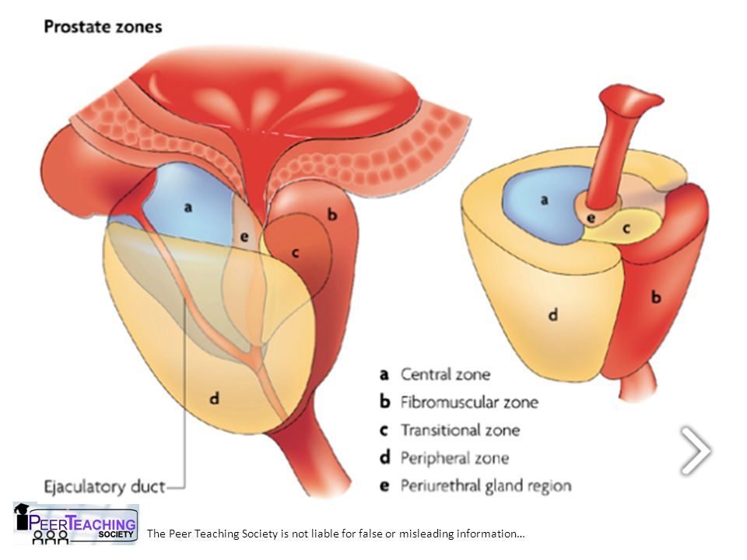

Slide 23
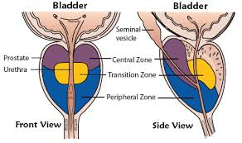

Slide 24
Lobes of Prostate
Anatomically It is divided into 5 lobes according to their relation to the urethra:
Anterior (isthmus):
Lies anterior to the urethra, It is fibromuscular.
Posterior:
Posterior to the urethra and inferior to the ejaculatory ducts.
Two lateral:
On each side of the urethra.
5. Middle (median):
Between the urethra and ejaculatory ducts & closely related to neck of urinary bladder.
The median & lateral lobes are rich in glandular tissue.

Slide 25
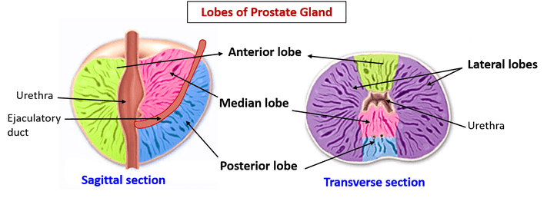

Slide 26
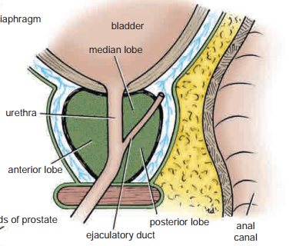

Slide 27
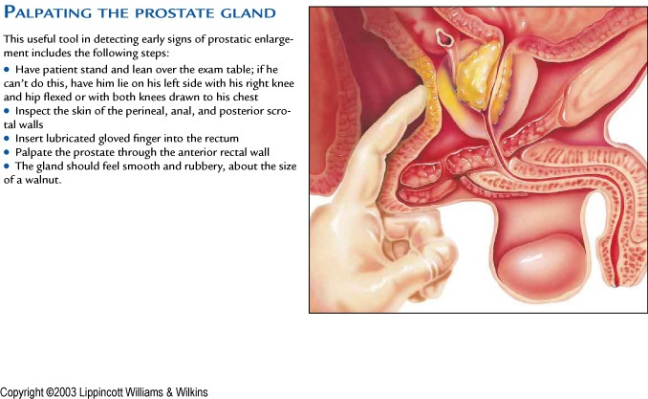
UB
R
SP
D
UG

Slide 28
Blood supply
Arteries
Branches of the inferior vesical and middle rectal arteries.
Veins
The veins form the prostatic venous plexus, which lies outside the capsule of the prostate.
The prostatic plexus receives the deep dorsal vein of the penis and numerous vesical veins and drains into the internal iliac veins.

Slide 29
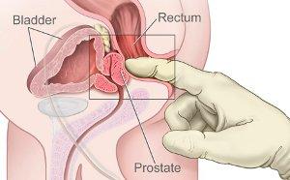
DRE

Slide 30
Urethra
The female urethra is about 1.5 in. (3.8 cm) long.
It extends from the neck of the bladder to the external meatus, where
it opens into the vestibule about 1 in. (2.5 cm) below the clitoris .
It traverses the sphincter urethrae and lies immediately in front of the vagina.
At the sides of the external urethral meatus are the small openings of the ducts of the paraurethral glands.
The urethra can be dilated relatively easily.

Slide 31
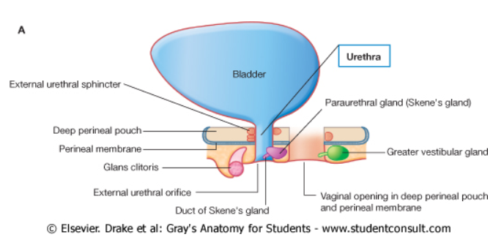

Slide 32
Male urethra
Prostatic urethra: it is 1 ½ inch-widest & it is the most dilatable part.
Membranous urethra: ½ inch long, lies within the urogenital diaphragm surrounded by sphincter urethrae muscle ,it is least dilatable part of urethra
Penile urethra: 6 inch long, enclosed in the bulb, corpus spongiosum and glans of penis.
The part of urethra that lies in glans penis is dilated to form fossa terminalis.
The bulbourethral glands open into penile urethra below urogenital diaphragm.
The external meatus is the narrowest

Slide 33
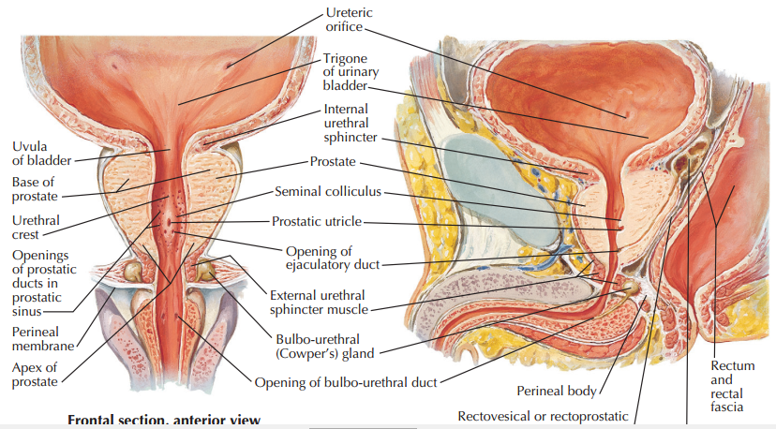

Slide 34
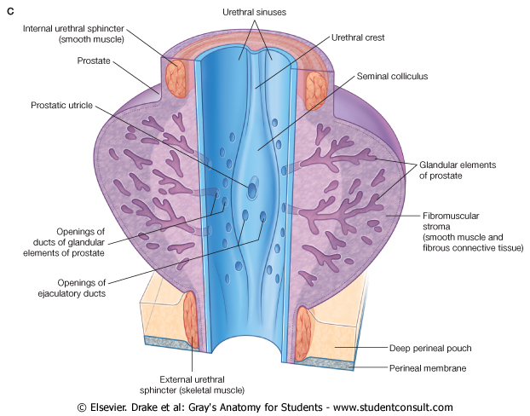

Slide 35
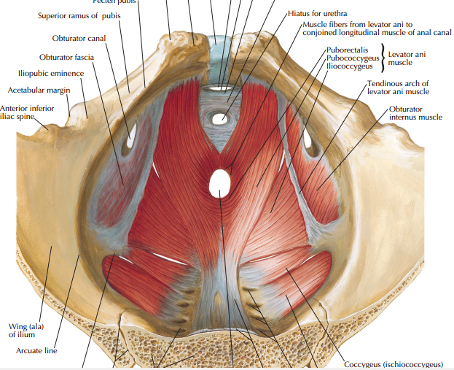

Slide 36
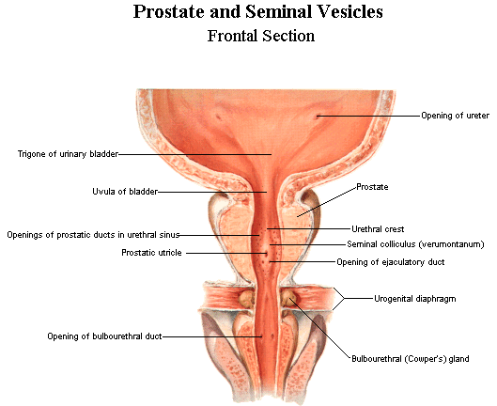

Slide 37
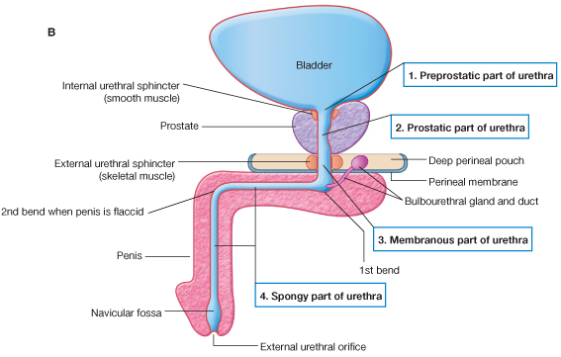

Slide 38
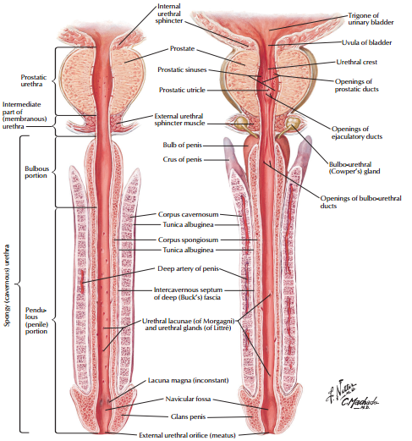

Slide 39
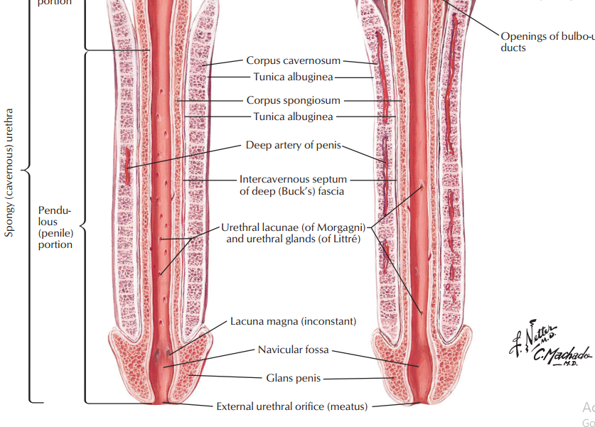

Slide 40
Urethra
Sphincters keep the urethra closed when urine is not being passed:
  Internal urethral sphincter – involuntary sphincter at the bladder-urethra junction
  External urethral sphincter – voluntary sphincter surrounding the urethra as it passes through the urogenital diaphragm

Slide 41


