Slide 1
Perineum I
Dr Abdul Hafeez Khan

Slide 2
Perineum Anatomy
The perineum is an anatomical region beneath the pelvis.
It is located between the thighs, and represents the most inferior part of the pelvic outlet.
The perineum is separated from the pelvic cavity superiorly by the pelvic floor.
This region contains structures that support the urogenital and gastrointestinal systems

Slide 3
Perineum
In clinical practice, the term “perineum” is frequently used to describe the area between the external genitalia and the anus
In anatomical terms, the perineum is a diamond-shaped structure
There are two main ways in which the boundaries of the perineum can be described
bony margins
surface anatomy of the perineum

Slide 4
Anatomical Borders
The anatomical borders of the perineum are:
Anterior – pubic symphysis.
Posterior – tip of the coccyx.
Laterally – inferior pubic rami and inferior ischial rami, and the sacrotuberous ligament.
Roof – pelvic floor.
Base – skin and fascia.

Slide 5
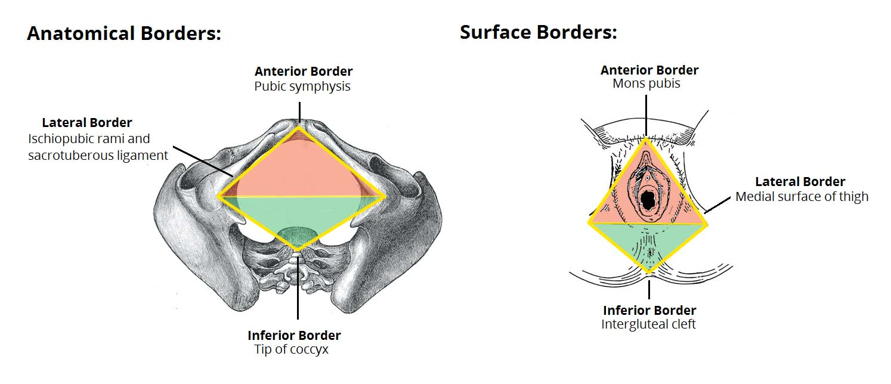

Slide 6
Surface anatomy
The surface boundaries are best shown when the lower limbs are abducted, and a diamond shape is depicted:
Anterior – Mons pubis in females, base of the penis in males
Laterally – medial surfaces of the thighs
Posterior – superior end of the intergluteal cleft

Slide 7
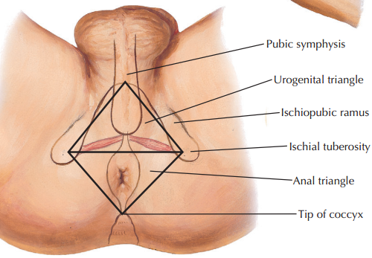

Slide 8
Division of Perineum
The perineum can be subdivided by a theoretical line drawn transversely between the ischial tuberosities.
This split forms the
Anterior urogenital and
Posterior anal triangles.

Slide 9
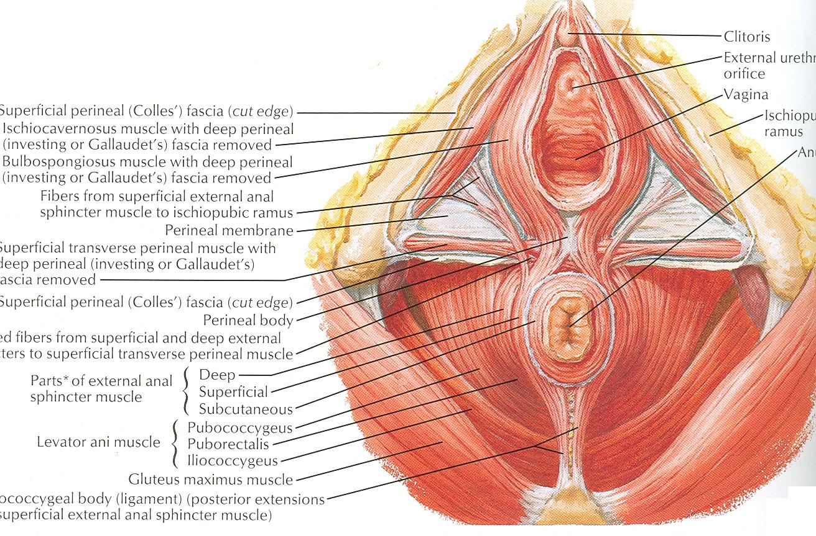

Slide 10
Urogenital Triangle
The urogenital triangle is the anterior half of the perineum.
It is bounded by the pubic symphysis, ischiopubic rami, and a theoretical line between the two ischial tuberosities.
The triangle is associated with the structures of the urogenital system
The external genitalia
And urethra.

Slide 11
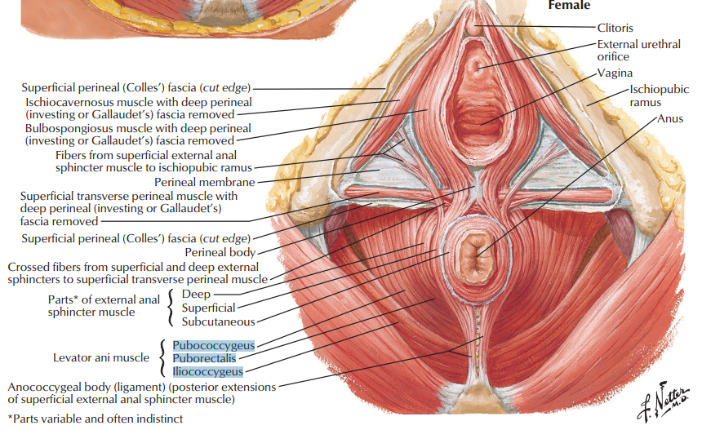

Slide 12
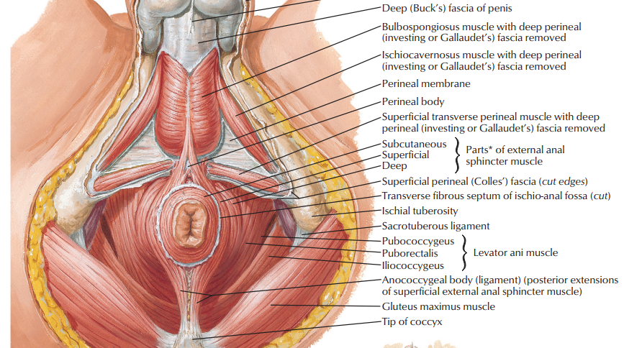

Slide 13
Anal Triangle
The anal triangle is the posterior half of the perineum.
It is bounded by the coccyx, sacrotuberous ligaments, and a theoretical line between the ischial tuberosities.
The main contents of the anal triangle are:
Anal aperture – the opening of the anus.
ii. External anal sphincter muscle – voluntary muscle responsible for opening and closing the anus.
iii. Ischioanal fossa – spaces located laterally to the anus.

Slide 14
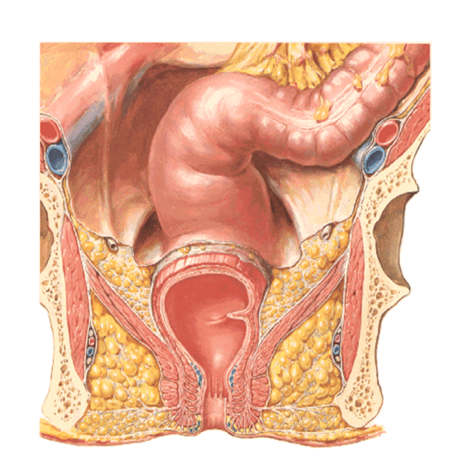
ischiorectal fossa

Slide 15
Ischoi-rectal (Ischio-anal) Fossa
Its base is the skin of perineum
Its medial wall is levator ani & anal canal
Its lateral wall is obturator internus, covered with pelvic fascia

Slide 16
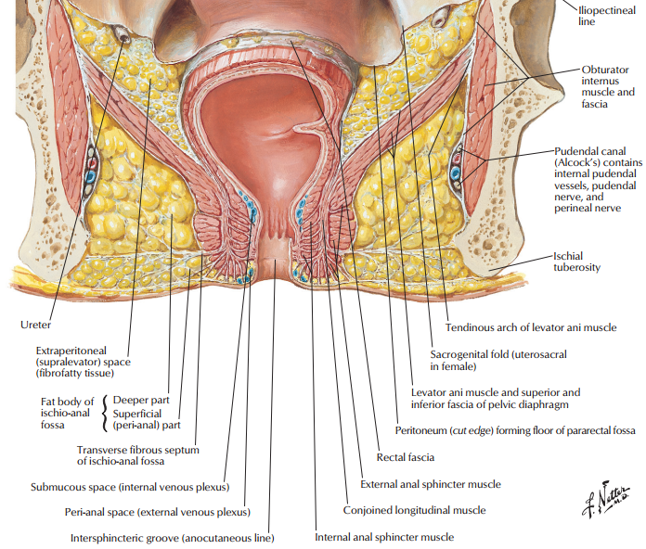

Slide 17
Contents
Ischiorectal fossa contents are:
Soft ischiorectal fat
Inferior rectal vessels pass above the fat to reach medial wall
Perineal branch of S4
Contents of Pudendal canal (Alcock’s canal)

Slide 18
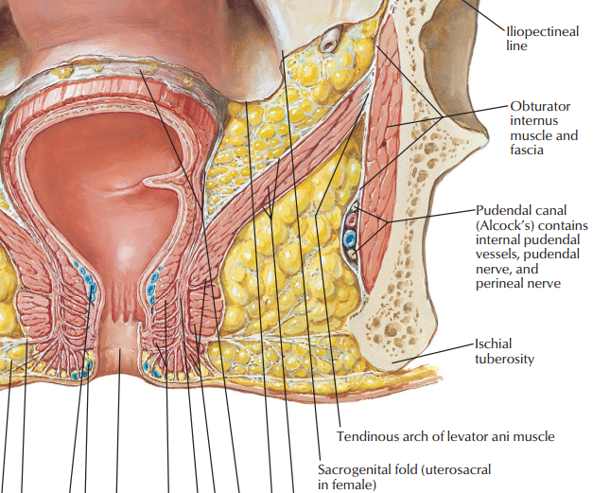

Slide 19
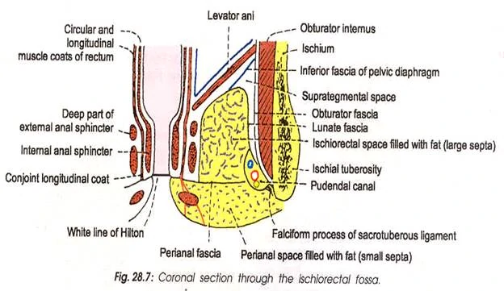

Slide 20
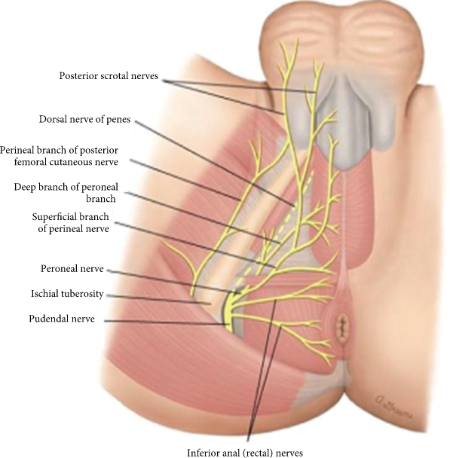

Slide 21
Perineal body
The perineal body is an irregular fibromuscular mass.
It is located at the junction of the urogenital and anal triangles – the central point of the perineum.
This structure contains skeletal muscle, smooth muscle, collagenous and elastic fibres.

Slide 22
Importance of perineal body
It acts as a point of attachment for muscle fibres from the pelvic floor and the perineum itself:
Levator ani (part of the pelvic floor).
Bulbospongiosus muscle.
Superficial and deep transverse perineal muscles.
External anal sphincter muscle.
External urethral sphincter muscle fibres.
In women, it acts as a tear resistant body between the vagina and the external anal sphincter, supporting the posterior part of the vaginal wall against prolapse.

Slide 23
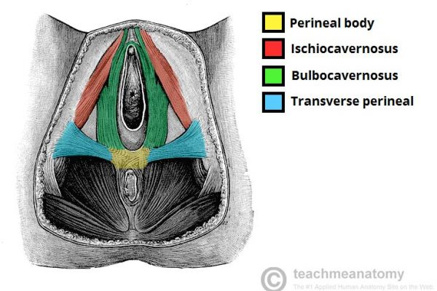

Slide 24
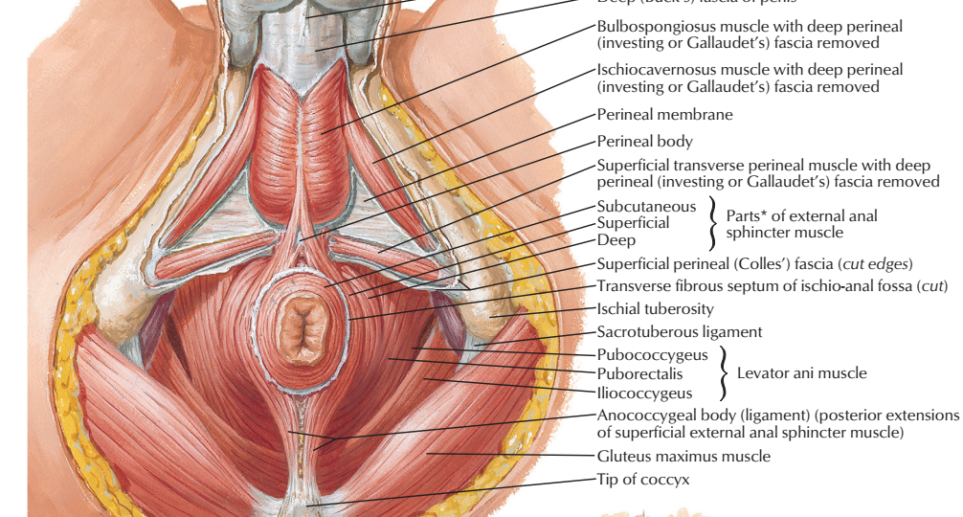

Slide 25


