Slide 1
The Pelvic Floor
Dr Abdul Hafeez Khan

Slide 2
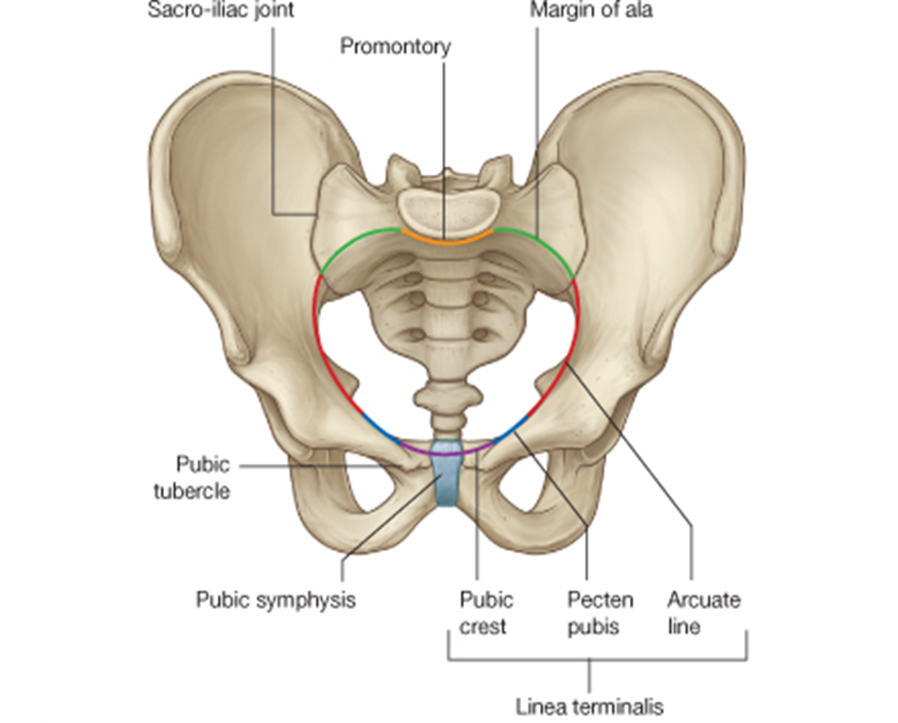

Slide 3
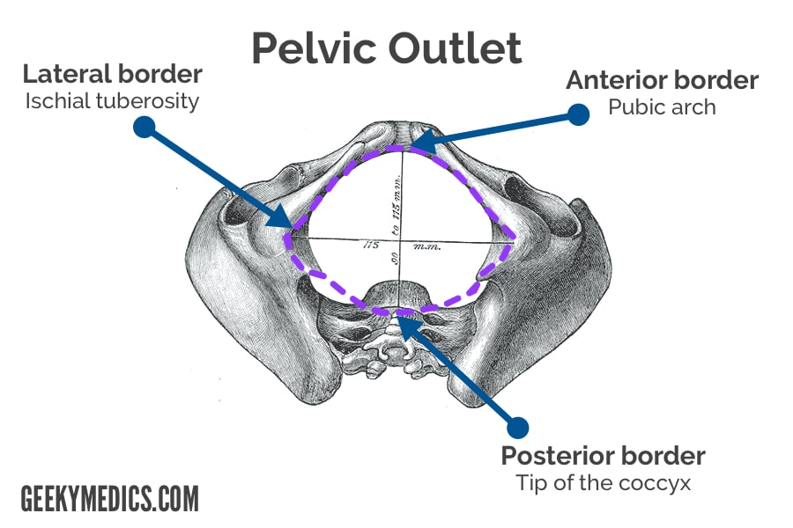

Slide 4
Pelvic Floor Anatomy
What is the pelvic floor?
“A complex web of muscle, fascia and fibrous tissue that helps support the pelvic organs”
Note: It is not just muscle!!!! Fascia and fibrous tissue are important too.

Slide 5
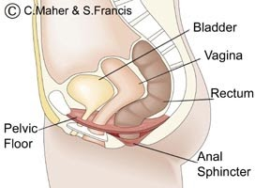
Muscular Components of the Pelvic Floor
Can be split into 2 layers:
1. Deep pelvic floor muscular layer (internal)
  Levator Ani
  Coccygeus
2. Superficial pelvic floor muscular layer (external)
  Urogenital triangle
  External anal sphincter

Slide 6
Muscular Component of the Pelvic Floor
Levator Ani
Deep Pelvic Floor Muscles (Internal)
Coccygeus
Pelvic floor muscles
Superficial Pelvic Floor Muscles (External)
Urogenital triangle
External Anal Sphincter

Slide 7
Deep Pelvic Floor Muscles: Levator Ani
Levator Ani (lifts Anus)
Function: Lifts to support the pelvic organs, removing strain on the endopelvic fascia.
4 separate muscles:
    Levator Prostate (Sphincter vagina)
    Puborectalis
    Pubococcygeus
    Iliococcygeus

Slide 8
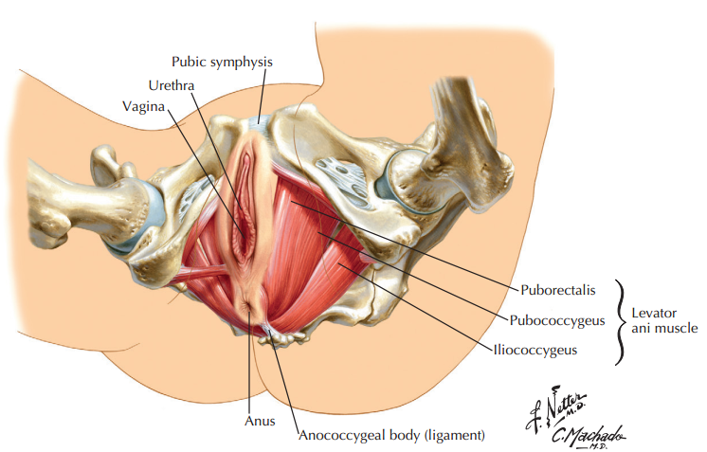

Slide 9
Levator Ani
The levator ani muscle is a wide thin sheet that has a linear origin from
Back of the body of the pubis,
A tendinous arch formed by a thickening of the fascia covering the obturator internus
Spine of the ischium.
From this extensive origin, groups of fibers sweep downward and medially to their insertion.

Slide 10
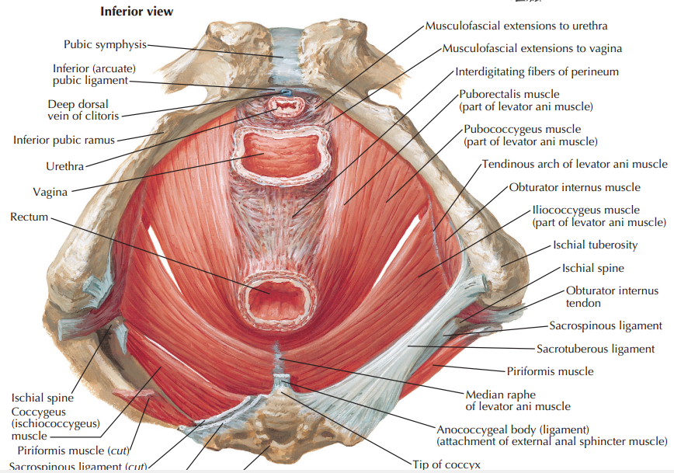

Slide 11
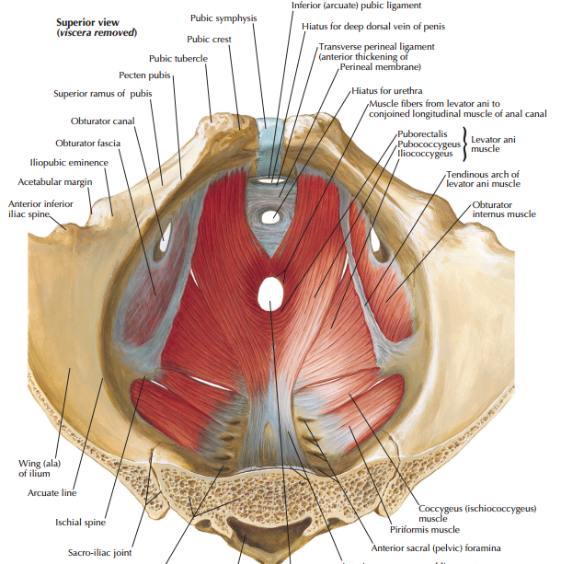

Slide 12
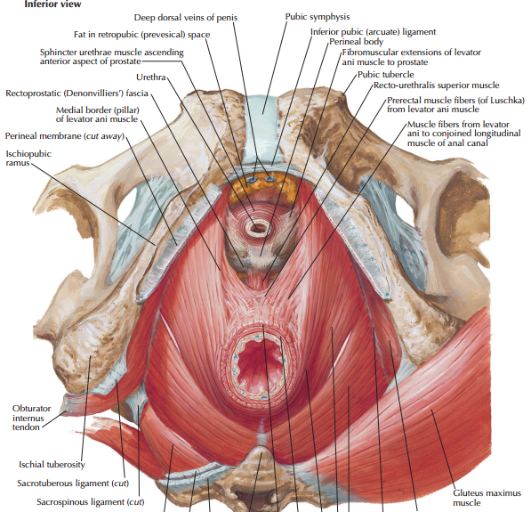

Slide 13
Levator Ani (Anterior fibers)
The levator prostatae or sphincter vaginae
form a sling around the prostate or vagina
inserted into a mass of fbrous tissue, called the perineal body.
The levator prostatae support the prostate and stabilize the perineal body.
The sphincter vaginae constrict the vagina and stabilize the perineal body

Slide 16
Levator Ani (Intermediate fibers)
The Puborectalis & Pubococcygeus
Forms a sling around the junction of the rectum and anal canal.
The pubococcygeus passes posteriorly to be inserted into a small fibrous mass, called the anococcygeal body, between the tip of the coccyx and the anal canal

Slide 17
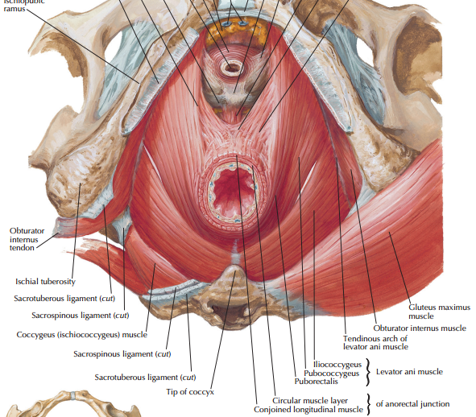

Slide 18
Pubo-Rectalis
It is fibres of the two levator ani muscles, forming a sling around the junction of rectum & anal canal.
It is attached in front to pubic bones.
At the junction of rectum & anal canal, the internal sphincter, deep part of external sphincter & puborectalis muscles form a ring called anorectal ring which can be felt on rectal examination.

Slide 19
Pubo-Rectalis
  PR creates a U-shaped sling around the anorectal junction.
  When it relaxes, it allow widening of the anorectal angle for bowels to open.
  Therefore it is important in maintaining faecal control (by contracting) and allowing defecation (by relaxing).
  Can cause chronic constipation if overactive.

Slide 20
Levator Ani (Posterior fibers)
The iliococcygeus
is inserted into the anococcygeal body and the coccyx.

Slide 22
Levator Ani
  Nerve Supply:
  The perineal branch of the fourth sacral nerve and
  The perineal branch of the pudendal nerve
  Action:
  Efficient muscular sling that supports and maintains the pelvic viscera in position.
  They resist the rise in intra-pelvic pressure during the straining and expulsive efforts of the abdominal muscles.
  They also have an important sphincter action on the anorectal junction
  In the female they serve also as a sphincter of the vagina

Slide 23
Deep Pelvic Floor Muscles: Coccygeus
Levator Ani
Deep Pelvic Floor Muscles (Internal)
Coccygeus
Pelvic floor muscles
Superficial Pelvic Floor Muscles (External)
Urogenital triangle
External Anal Sphincter

Slide 24
Coccygeus
Origin:
The spine of the ischium
Insertion:
Lower end of the sacrum and coccyx.
Action:
The two muscles assist the levator ani in supporting the pelvic viscera.
Nerve supply:
A branch of the 4th and 5th sacral nerves

Slide 25
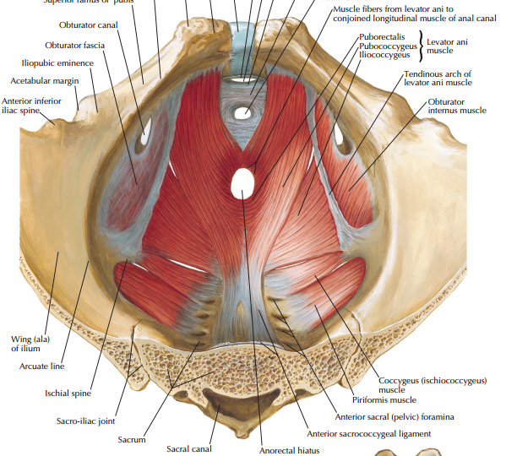

Slide 26
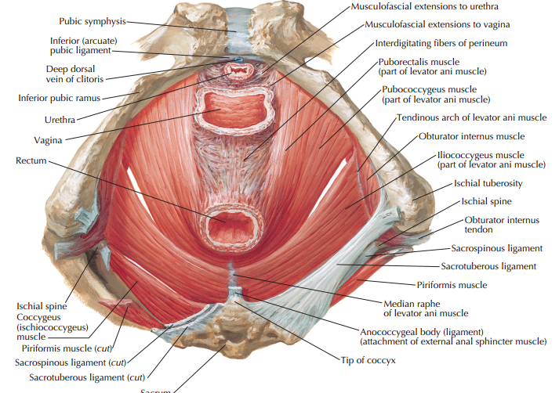

Slide 27
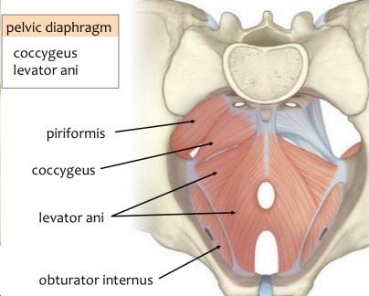
Deep Pelvic Floor Muscles: Coccygeus
Would control the tail if we had one.
Doesn’t elevate the anus.
Is thin and under developed due to evolution
Coccygeus

Slide 28
Pelvic fascia
The pelvic fascia is formed of connective tissue and is continuous above with the fascia lining the abdominal walls.
Below it is continuous with the fascia of the perineum.
The pelvic fascia can be divided into parietal and visceral layers

Slide 29
Pelvic fascia (Parietal)
It lines the walls of the pelvis
Named according to the muscle it overlies.
As the pelvic diaphragm is deficient anteriorly, It becomes continuous with the fascia covering the inferior surface of the pelvic diaphragm in the perineum.

Slide 30
Pelvic fascia (Visceral)
The visceral layer of pelvic fascia covers and supports all the pelvic viscera.
In certain locations, the fascia thickens and extends from the viscus to the pelvic walls
These fascial ligaments are named according to their attachments

Slide 31
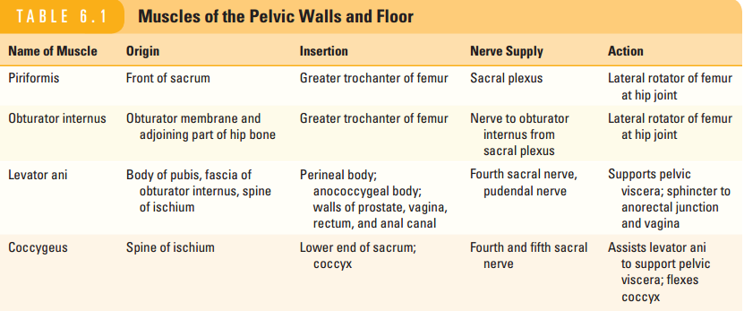

Slide 32
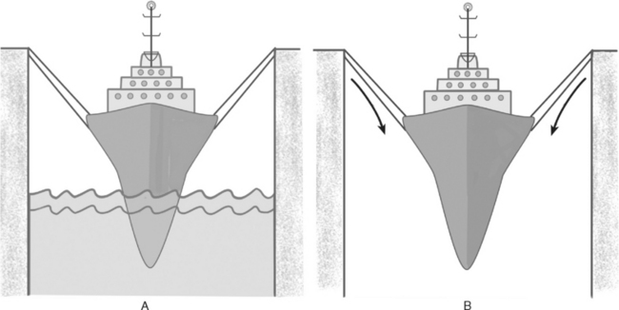
Boat in the dock analogy
Boat = pelvic organs
Ropes = fascia/ ligaments suspending the organs within he pelvis
Water = Pelvic floor muscles (levator ani) supporting the pelvic organs from the bottom up
Note: If the pelvic floor is weak there is increased strain on the fascia
If the fascia is torn/ stretched during child birth there is increased pressure on pelvic floor
Both may result in prolapse

Slide 33
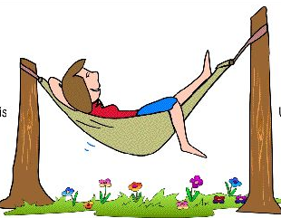
Hammock analogy
Legs = Rectum
Body = Uterus
Head = Bladder
Ropes = Fascia
Fascia
Hammock = Levator Ani
Lifts pelvic organs taking strain off fascia

Slide 34
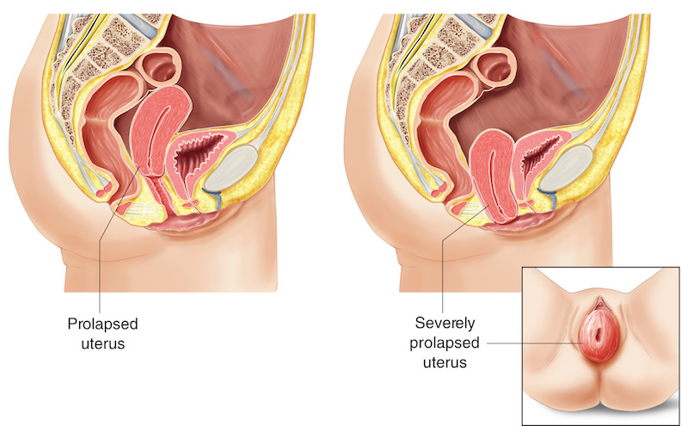
Prolapse: Uterine prolapse
Dropping of uterus down the vagina

Slide 35
Assessment
A 72-year-old woman who has delivered four kids vaginally complains of pelvic floor weakness. Clinical examination reveals an uterine prolapse. What organ can protrude into the vagina additionally if the posterior vaginal fornix (fornix vaginae) is weakened too?
Anal canal
Kidney
Urethra
Rectum
Urinary bladder
Key: d) Rectum

Slide 36
Assessment
Which muscles form the levator ani muscle (musculus levator ani)?
External anal sphincter
Coccygeus
Pubo-c0ccygeus
Pubo-rectalis
Iliococcygeus
Key: c,d,e

Slide 37
Assessment
A 26-year-old woman comes to the doctor’s office complaining of an inability of controlling gas and bowel movements following vaginal childbirth. Upon physical examination and further tests the doctor confirms a diagnosis of postpartum bowel incontinence. He explains to the patient that the incontinence resulted from a damage of the pelvic floor muscles and/or nerves during childbirth. Which of the following muscles are involved in continence control and are therefore likely damaged in this case study?
Levator ani muscle
Obturator internus
External anal sphincter
Internal anal sphincter
External urethral sphicter
Key: a,c,d

Slide 38


